Slide 1

Module 4 –Kafka

Slide 2





Spark Streaming-Kafka
Obvious reasons to learn Kafka

Slide 3
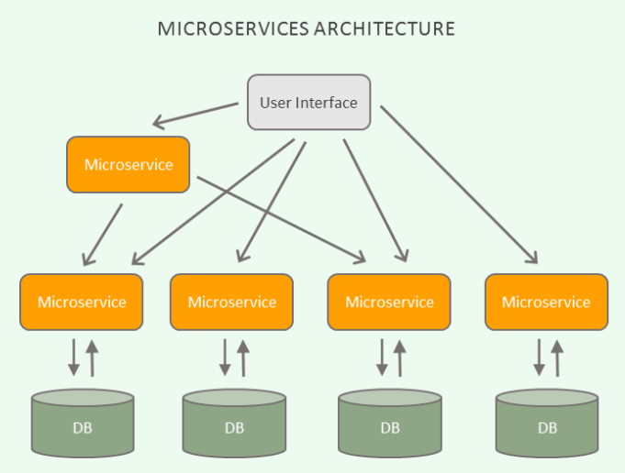
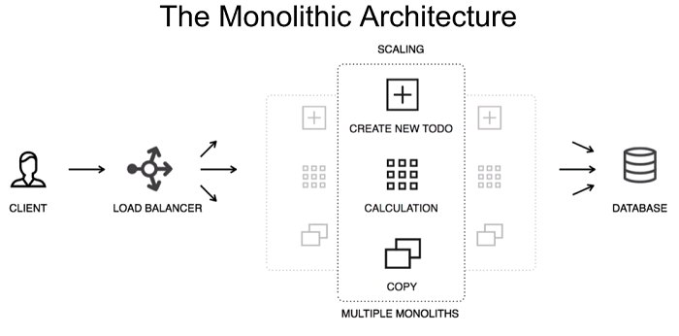
Spark Streaming-Kafka
Why Kafka?- Evolution from Developer’s View

Slide 4
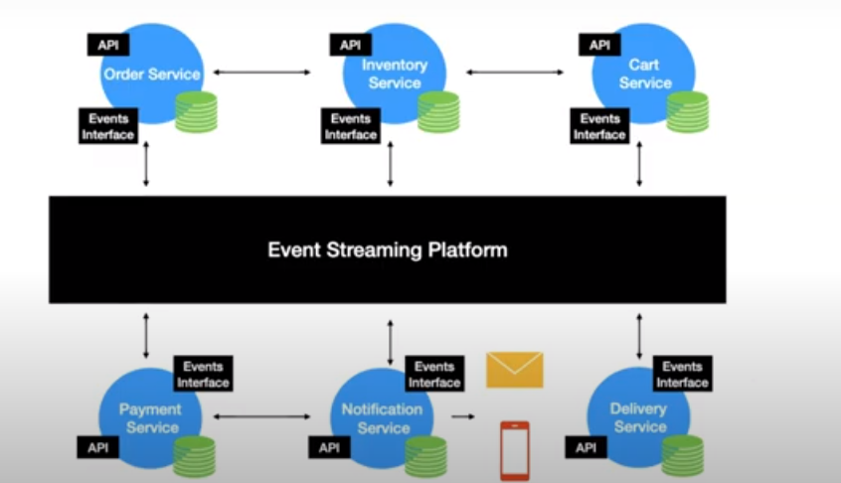
Spark Streaming-Kafka
Demand of this era applications
Stream processing requires processing of events
Think of an event as something that happens at a time
For example
“Student with ID 23489 entered building”

Slide 5
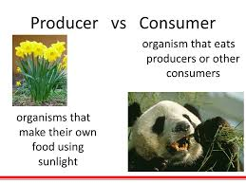
Spark Streaming-Kafka
What is Event Streaming Platform?
Allows produce and Consume
No Clue
Stores Streams
Process
“ Apache Kafka”

Slide 6
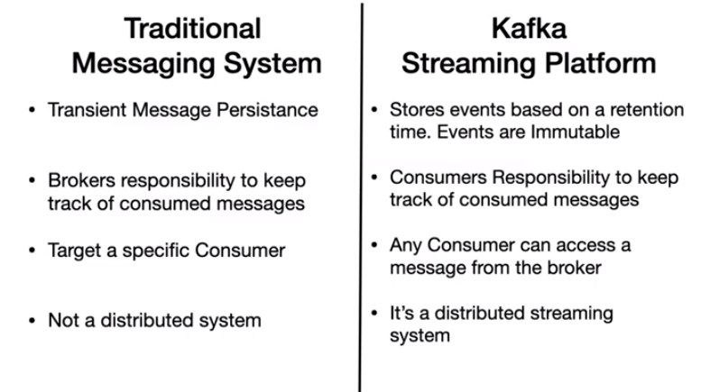
Spark Streaming-Kafka
Is Kafka a enterprise messaging system?

Slide 7
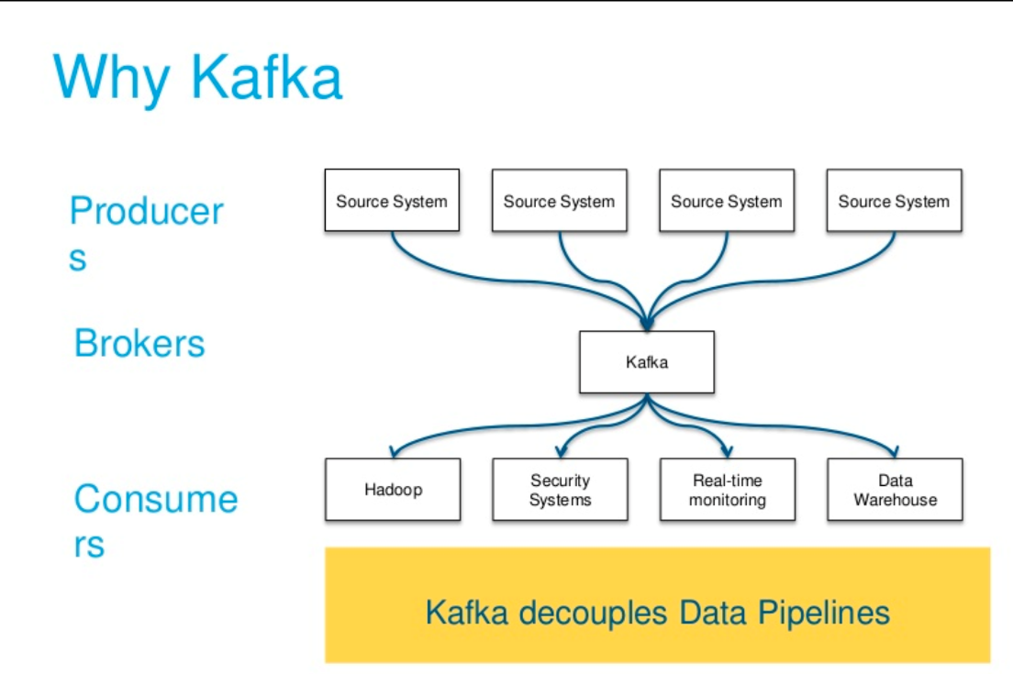
Spark Streaming
Why Kafka?
Can we have an intermediary that connects
Different sources
Multiple backends
Decouple the pipeline so that producers and consumers do not need to know about each other

Slide 8
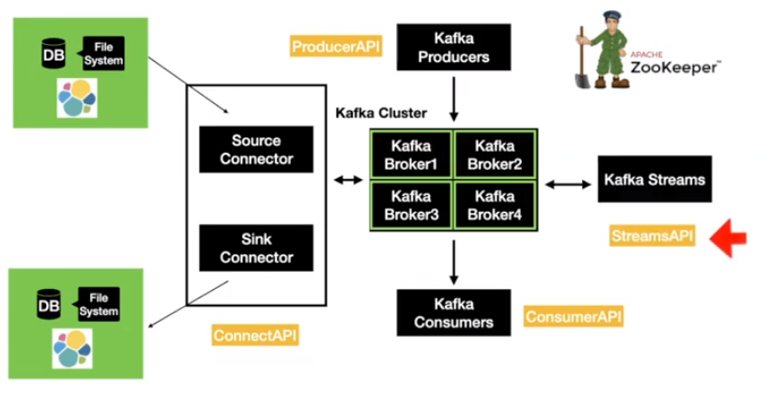
Spark Streaming-Kafka
Kafka Terminologies

Slide 9
Spark Streaming-Kafka
Topic based routing
Publishers send messages with topic labels
Subscribers subscribe to topics
And will receive all messages on that topic
Example
Subscribe to all fire sensors in b block

Slide 10
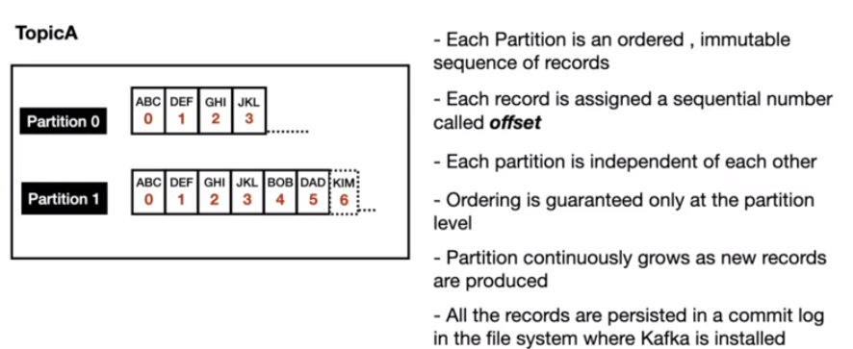
Spark Streaming-Kafka
Partitions

Slide 11
Spark Streaming-Kafka
Content based routing
Subscribers define matching criteria
And will receive all messages that match the criteria
Example
Subscribe to all fire sensors in b block

Slide 12
Spark Streaming-Kafka
Communication advantages/disadvantages
Pros
Cons
No hard-wired connections between publishers and subscribers
Flexible: Easy to add and remove publishers or subscribers
Design and maintenance of topics
Performance overhead due to communication infrastructure

Slide 13
THANK YOU

